Slide 1
BONE AGE PREDICTION
Submitted by:
Aruna Gurung
Parminder Kaur
Rewant Sharma
Rohit Kumar
Saurabh Gangwar

Slide 2
01
INTRODUCTION
Application of Bone Age Prediction:
Diagnosis of Growth disorders
Orthopaedics
Forensic Medicine
Paediatric care, etc
Project Objective:
Our project aims to accurately predict bone age using X-ray images leveraging Convolutional Neural Networks (CNNs) and other deep learning models.

Slide 3
TASK DISTRIBUTION
Name | Task
Aruna Gurung | EDA, Presentation
Parminder Kaur | Report & Documentation
Rewant Sharma | Model Building
Rohit Kumar | Model Building, Model Evaluation
Saurabh Gangwar | Data Preprocessing, Model Deployment

Slide 4
02
DATASET OVERVIEW
Dataset Description: hand X-ray images of people.
Dataset Size: 10GB
Source: Kaggle
Training dataset: 12,611 images with corresponding bone age annotations.
Test Dataset: Images without labels.

Slide 5
DATA CLEANING & PREPROCESSING
03
Added Gender Feature
Image Resizing & Normalization
Noise Reduction
‘male’ column transformation using mapping
Resized images to 224x224 px and scaled pixel values in the range [0,1]
Used denoising to reduce noise
Contrast Enhancement
ROI (Region of Interest) Extraction
Enhanced contrast to improve bone structure visibility
Focused on extracting the central region of the image where the hand is located

Slide 6
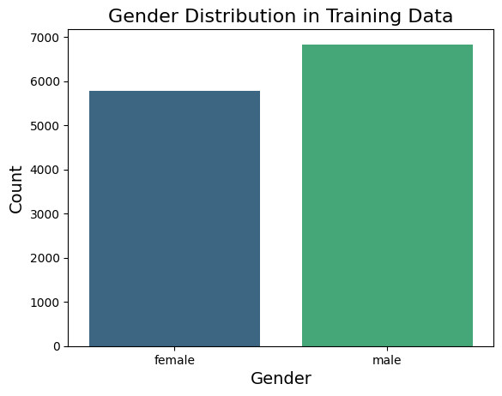
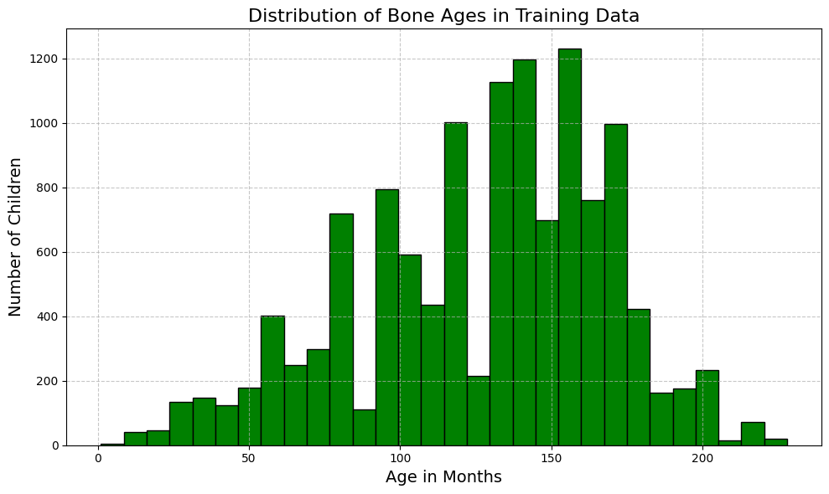
04
EXPLORATORY DATA ANALYSIS
The distribution is concentrated towards older children, with the highest frequency of bone ages between 100 & 150 months indicating more samples from this specific age range in the dataset.
Bar chart representing higher no.of male instances compared to female instances. Relatively balanced distribution which is important for unbaised model training.

Slide 7
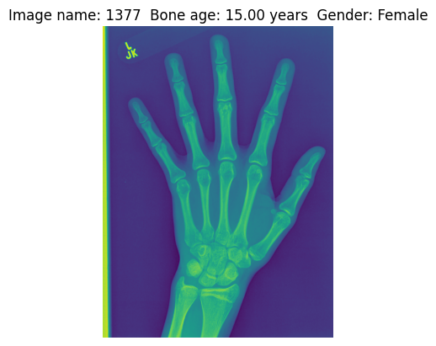
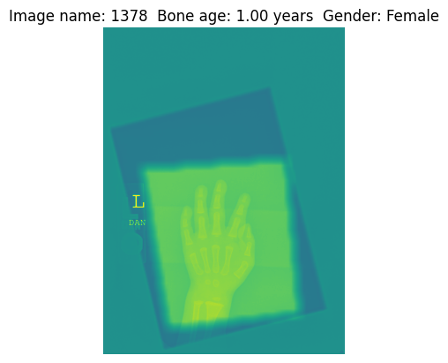
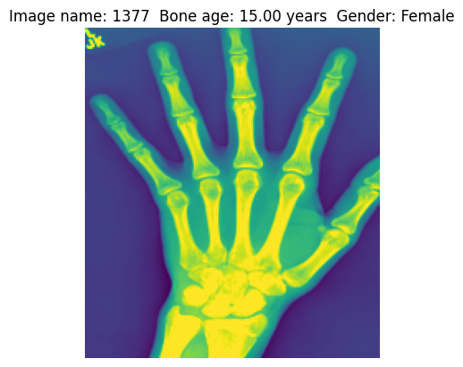
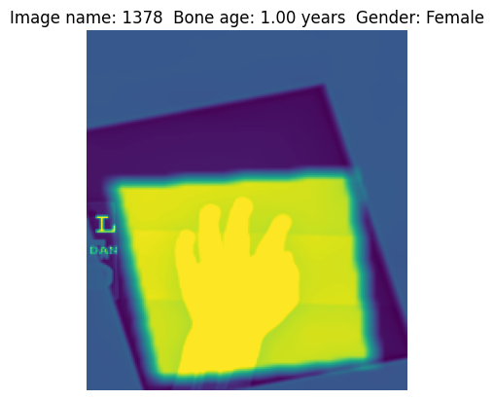
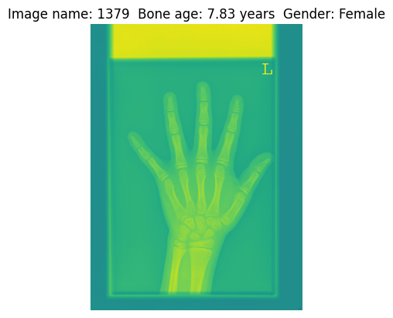
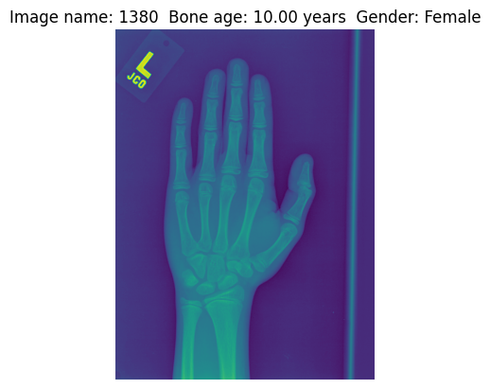
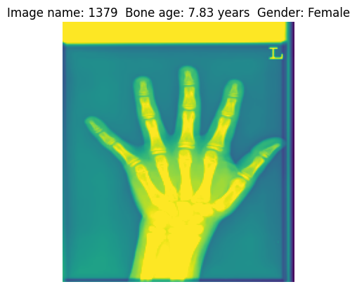
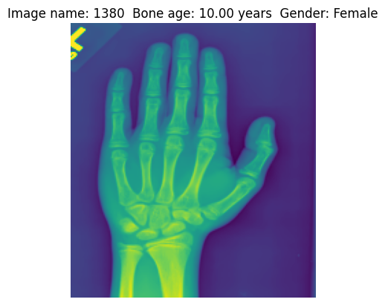
Images from Training Dataset
Before Preprocessing
After Preprocessing

Slide 8
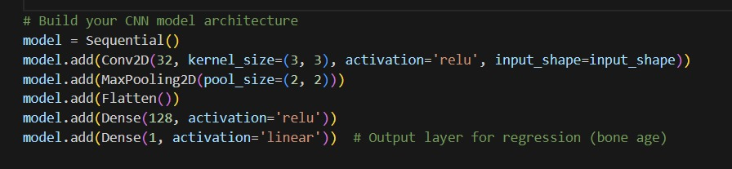
MODEL USED
05
Convolutional Neural Network (CNN) for bone age prediction. It includes a convolutional layer with 32 filters, followed by a max-pooling layer, a flattening layer, and two dense layers. The final dense layer has a single output neuron with a linear activation function, indicating that the model is designed for a regression task to predict bone age.

Slide 9
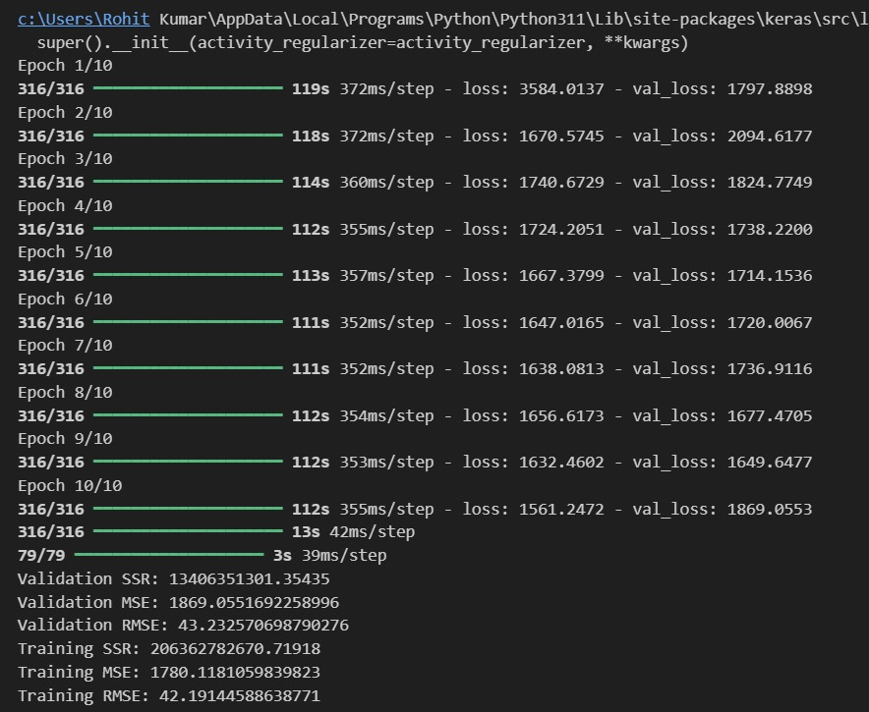
06
RESULT

Slide 10
HYPERPARAMETER TUNING
07

Slide 11
DEMO

Slide 12
CONCLUSION
We were able to successfully predict bone age from X-ray images

Slide 13
THANK YOU

